Slide 1
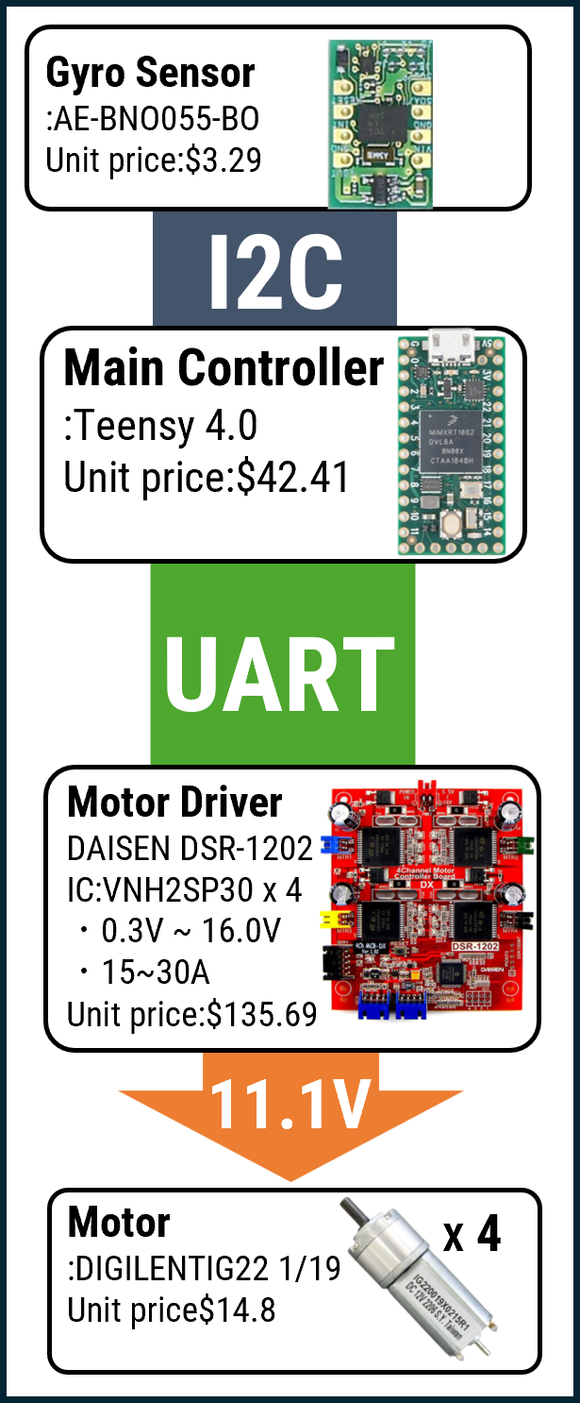

How do you use your processor to move your motors?
START
Get gyro data
For more details, please refer to the link：https://github.com/MUNAKATA-EPC/Aegis_2025/blob/main/2025/Salvador/attack%EF%BC%86defence/Software/white/main%20w/include/gyro.h
Determine motor speed
For more details, please refer to the link：https://github.com/MUNAKATA-EPC/Aegis_2025/blob/main/2025/Salvador/attack%EF%BC%86defence/Software/white/main%20w/include/motor.h
END

Slide 2
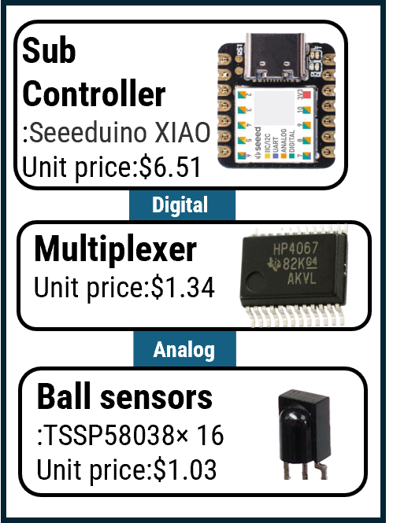
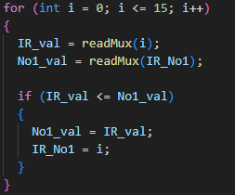
How do you find where the ball is? How do you read the data from the ball detection sensors or camera?
START
Get analog value
Vector composition
Calculate the ball angle
END
For more details, please refer to the link：https://github.com/MUNAKATA-EPC/Aegis_2025/tree/main/2025/Salvador/attack%EF%BC%86defence/Software/white/defense_IRvector%20w

Slide 3
How does your algorithm work to catch the ball? Is there a difference between your robots in how they move towards the ball? Explain the differences.
Attacker
Goalkeeper
START
START
Get the angle of the ball
Line tracing
Moves according to the angle of the ball
Get the ball angle and the goal angle
For more details, please refer to the link：https://github.com/MUNAKATA-EPC/Aegis_2025/tree/main/2025/Salvador/attack%EF%BC%86defence/Software
Is the ball in the ball capture zone
Y
Kick the ball
Move along those lines
N
END
END

Slide 4
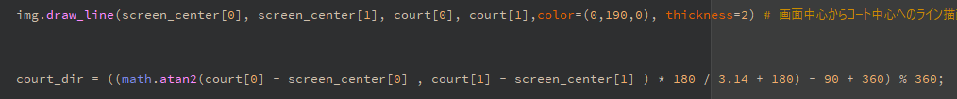
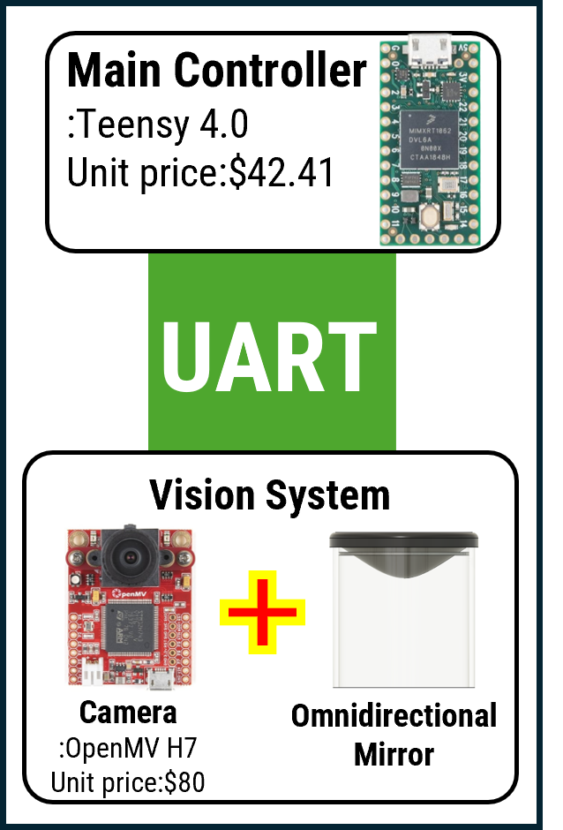
How does your robot find the lines to stay inside the field? What algorithms do you use to avoid going out of bounds?
START
For more details, please refer to the link：https://github.com/MUNAKATA-EPC/Aegis_2025/blob/main/2025/Salvador/attack%EF%BC%86defence/Software/white/camera%20w.py
Calculate the court angle
Did the line sensor react
N
Move as usual
Y
Move towards the center of the court
For more details, please refer to the link：https://github.com/MUNAKATA-EPC/Aegis_2025/tree/main/2025/Salvador/attack%EF%BC%86defence/Software
END

Slide 5
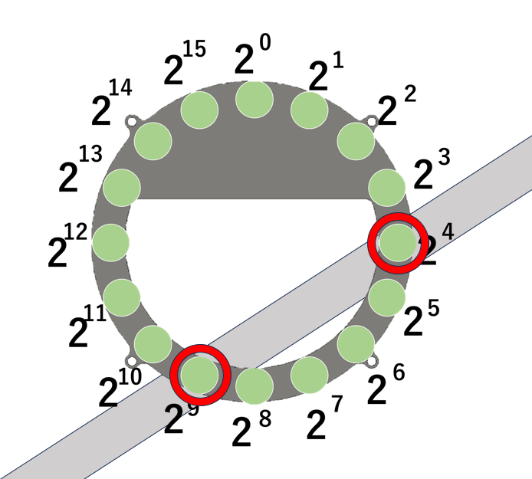
Innovations
Based on the digital values (0 or 1) obtained from the line sensors, calculations are performed corresponding to the sensor numbers that detected a response (value of 1). Specifically, for each activated sensor number, we calculate 2number2^{\text{number}}2number and then sum all these values.
For example, if sensors number 4 and 9 respond, the calculation is: 2^4+2^9=16+512=528
Using this method, the response states of multiple sensors can be managed as a single summed value, allowing for fast processing and state detection through bitwise operations. This summed value is then transmitted to the Teensy 4.0 via serial communication.
For more details, please refer to the link：https://github.com/MUNAKATA-EPC/Aegis_2025/tree/main/2025/Salvador/attack%EF%BC%86defence/Software/white/defence_LINE%20w

Slide 6
START
On the Teensy side, the received summed value is used to determine which sensors were activated. The processing steps are as follows:
1.Check the received summed value (for example, 528).
2.Starting from the highest sensor number, check whether the summed value is greater than or equal to 2^n (e.g., from n = 15 down to 0).
3.If the summed value is greater than or equal to 2^n, it is determined that sensor number n was activated, and 2^n is subtracted from the summed value.
4.Add sensor number n to the array of activated sensors.
5.Repeat this process until the summed value becomes zero.
6.Finally, all activated sensor numbers are stored in the array.
The summed value is zero
Y
Starting from n = 15 down to 0
N
2^n <= summed value
N
Y
Subtract 2^n from the summed value
Add n to the array
For more details, please refer to the link：https://github.com/MUNAKATA-EPC/Aegis_2025/blob/main/2025/Salvador/attack%EF%BC%86defence/Software/white/main%20w/include/linecul.h
END

